Slide 1
Communication Skills for Engineers (COMM 402-EC10) Week 4 – Sessions 7&8
Prepared by Stefany Salemeh

Slide 2

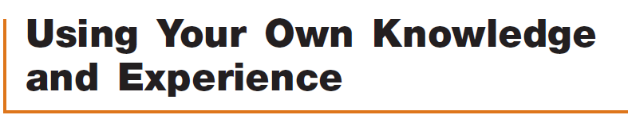


Before Writing a Speech: Gathering Materials
https://ua.edu.lb/en/library

Slide 3
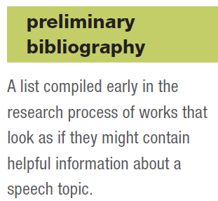
Tips for Doing Research
Start early
Make a preliminary bibliography
Take notes efficiently
Take plenty of notes
Make a separate entry for each note
Avoid plagiarism by distinguishing among quotes, paraphrases, and your own ideas.

Slide 4
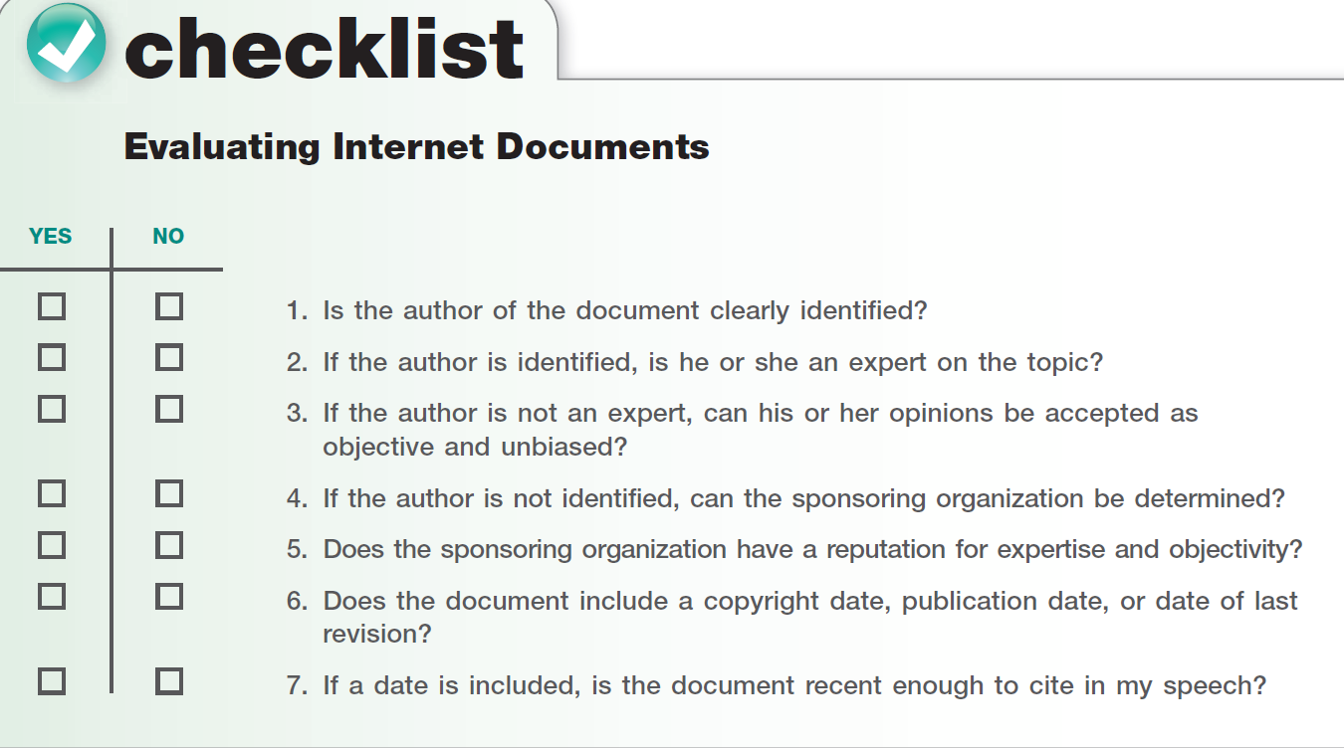

Slide 5
Another source: Interviewing
Before the interview:
Define the purpose of the interview
Decide whom to interview
Arrange the interview and prepare your questions
During the interview:
Keep the interview on track
Listen carefully
After the interview:
Review your notes as soon as possible

Slide 6
Think about your research:
If you think about what you are finding in your research, you will see your topic just a little bit differently. You will find new relationships, develop new questions, explore new angles.
As you learn more about the topic, you will formulate a central idea, begin to sketch out main points and supporting points, experiment with ways of organizing your thoughts.

Slide 7

Mini Research Challenge
With your partner, find one source that supports your topic and central idea. You will have 5 minutes.

Slide 8
IEEE Referencing
The Institute of Electrical and Electronics Engineers (IEEE) pronounced “I-triple-E” is a style for formatting research papers and citing sources used in all branches of engineering, computer science, and other technological fields. This reference list will be after your outline as well as at the end of your PowerPoint.
https://owl.purdue.edu/owl/research_and_citation/ieee_style/index.html

Slide 9
Oral Referencing
When you reference a study, statistic, anecdote, or information that is not your own, you reference it while speaking.
In most cases, you will need to identify some combination of the following:
The book, magazine, newspaper, or Web document you are citing.
The author or sponsoring organization of the document.
The author’s qualifications with regard to the topic.
The date on which the document was published, posted, or updated.
https://www.youtube.com/watch?v=iwNdNbKVrQA

Slide 10
Further Examples:
A recent study published in the Journal of Neuroscience by researchers at Duke University demonstrates just how problematic sleep deprivation can be for compulsive gamblers.
A December 2013 report from the U.S. Department of Agriculture found that due to improved logistics, technology, and transportation, we now import the same amount of fresh fruit as we produce domestically. That’s why you’re able to eat avocados, kiwis, strawberries, and blueberries year-round.
In an interview I conducted for this speech, Professor Elinor Sanchez of the Political Science Department said that the impact of lobbyists has so corrupted the American political system that many people have lost their faith in government to serve the public good.
In last month’s issue of Atlantic Monthly, senior editor Derek Thompson investigated employment patterns in the United States. He found that despite fears about part-time jobs becoming the new norm, we’re actually creating 225 full-time jobs for every new part-time job.

Slide 11
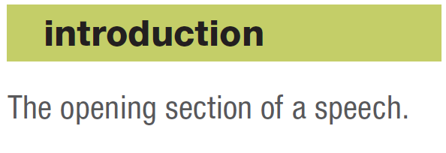
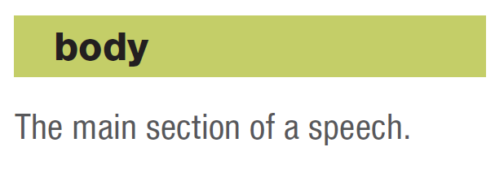
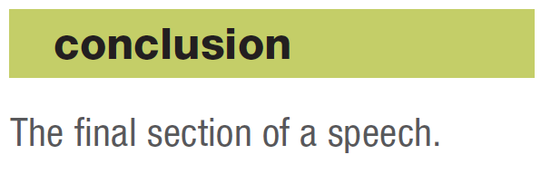
How to structure your speech

Slide 12
Informative Speech Example
https://www.youtube.com/watch?v=StPSgqwCnVk&t=34s

Slide 13
For my Aunt Josefina, life can be empty, even though she’s surrounded by tons of stuff. Walking into her living room, you’ll see stacks of magazines and newspapers, piles of clean and dirty laundry, and boxes of collectible figurines. But you won’t find a place to sit down. In her kitchen, you’ll see towers of dishes, scores of empty two-liter bottles, and over a dozen trash bags. But you won’t see a kitchen table.
Some people say Aunt Josefina is lazy. Others say she’s just dirty. But my family and I know the truth: Aunt Josefina suffers from a mental disorder known as Collyer’s Syndrome, or disposophobia. But you probably know it by its most common name: compulsive hoarding. Those who suffer from compulsive hoarding can’t bring themselves to get rid of anything. It doesn’t matter if the things are valuable; it only matters that they hold on to them.
Over the years, my family and I have become painfully aware of what life is like for a compulsive hoarder. But until researching the topic for this speech, I had no idea how widespread the disorder was. Gail Steketee and Randy Frost, authors of Stuff: Compulsive Hoarding and the Meaning of Things, report that anywhere from 6 million to 15 million Americans are compulsive hoarders.
Today I would like to introduce you to the world of compulsive hoarding. I will show you the seriousness of the problem, the impact it can have on individuals and families, and the ways it can be treated.
INTRODUCTION EXAMPLE

Slide 14
The Introduction
In most speech situations, the introduction has five objectives:
Get the attention and interest of your audience.
Startle the audience, question them, quote, or tell a story.
Reveal the topic of your speech.
Establish your credibility and goodwill.
Establish audience relevance.
Preview the body of the speech (state your central idea)

Slide 15

Tips for the Introduction
1. Keep the introduction brief (about 10 to 20 percent of your speech).
2. Be creative in devising your introduction.
3. Don’t worry about the introduction until after writing the body of your speech and after determining your main points.
4. Don’t start your speech until the audience is quieted down and focused on you.

Slide 16

Central Idea: It is a concise statement of what you will say in your speech, and it usually crystallizes in your thinking after you have done your research and have decided on the main points of your speech. The central idea usually encapsulates the main points to be developed in the body of your speech.
Microscopic in size, nanorobots are being developed for use in medicine, weaponry, and daily life.
What are nanorobots?
South Africa has many attractions for vacationers, including beautiful scenery, exotic wildlife, and bustling cities.
South Africa is an awesome place for a vacation.

Slide 17
Body Paragraphs
Main Point
Supporting details (explanation, examples, illustrations, data, facts, statistics)
Repeat (2 – 5 main points)
Example:
Nanorobots in medicine
Helps in targeted drug delivery

Slide 18
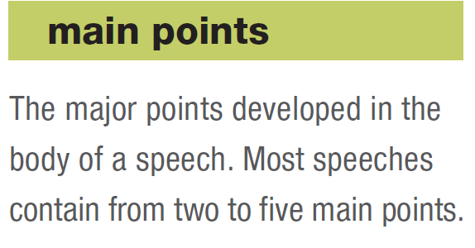
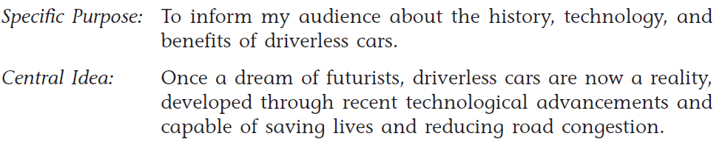
Example
Driverless cars today operate due to technological advancements like sensors, computer processing, and network connectivity.
Driverless cars are capable of saving lives
Driverless cars reduce road congestion.

Slide 19
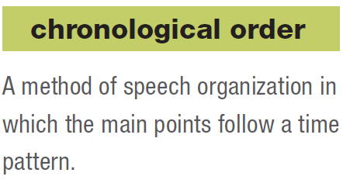
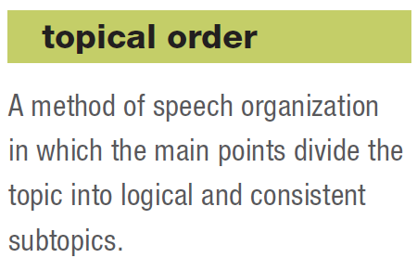
Clear organization is vital to public speaking. Listeners must be able to follow the progression of ideas in a speech from beginning to end.

Slide 20
Activity:
Read each specific purpose and write 3 main points for each. Make sure to follow a chronological or topical order.
1. To inform my audience about the process of developing a mobile application from start to finish.
2. To inform my audience about the main cybersecurity threats faced by computer systems today.

Slide 21
Supporting Materials: By themselves, main points are only assertions. Listeners need supporting materials to accept what a speaker says.
1. Example: A specific case used to illustrate or represent a group of people, ideas, conditions, experiences, or the like.
Brief example (specific case)
Extended example (story/anecdote)
Hypothetical example (an imaginary situation)
2. Statistics
3. Testimony
Expert testimony
Peer testimony

Slide 22
Fill out the table to figure out your supporting materials:
Main Point | What does the audience need to understand here? | Best Support Type | What will I show?

Slide 23
The Conclusion
No matter what kind of speech you are giving, the conclusion has two major functions:
To let the audience know you are ending the speech.
To reinforce the audience’s understanding of, or commitment to, the central idea.

Slide 24
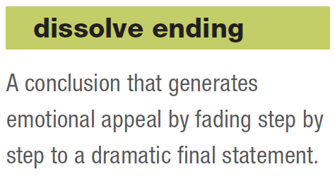
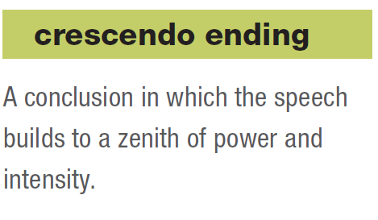
Different ways to end: 1. Summarize your speech 2. End with a quote 3. Make a dramatic statement 4. Refer to the introduction

Slide 25
Tips for the Conclusion:
1. Conclude with a bang, not a whimper. Select a conclusion that will have the greatest impact.
2. The conclusion will take no more than 5 to 10 percent of the speech.
3. Practice to ensure that can present it smoothly.

Slide 26
Today we have seen that compulsive hoarding is a serious mental disorder whose effects can be devastating for individuals and families. It’s also difficult to treat, which means that millions of Americans are left living a life of clutter and chaos.
My Aunt Josefina is one of those people. She says: “People look at my apartment and know I have a problem. I look at my apartment and know I have a problem. I’m trying to get it under control, but it’s a really long road.” For my Aunt Josefina and millions of others, the good news is that understanding the problem is the first step toward conquering all the stuff.
CONCLUSION EXAMPLE

Slide 27
Designing the Introduction
Choose the Hook (Scenario, Real World Problem, Surprising Statistic, Question, Example Case…)
Introduce the Topic
Audience Relevance: Why should your audience care?
Credibility Statement: Why are YOU presenting this?
Central idea (we already drafted this)

